Slide 1
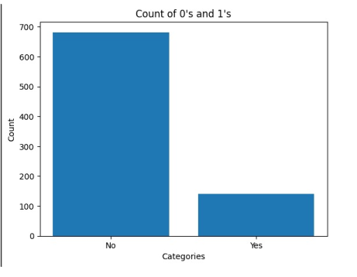
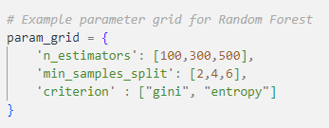


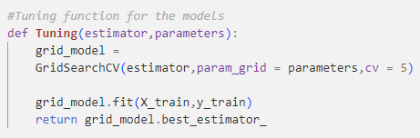
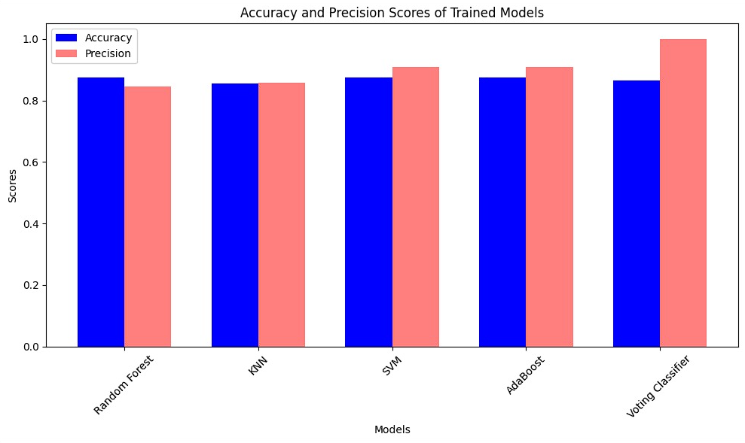
Hasan Can Dizdar
Employee Attrition
Suat Köroğlu
The secret to thriving in any business structure is the ability to attract and maintain highly skilled employees. One of the primary roles of a Human Resources analyst is understanding the variables that contribute to employee retention and those that lead to employee attrition. The provided dataset includes information about current and former employees. The objective is to identify and improve these factors to prevent loss of good people.
1. Introduction
2. Cleaning of the Data
The employee attrition dataset consists of 1030 instances and 34 features. Its objective is to identify factors influencing employee retention and departure. Analyzing these attributes helps us understand the key factors that influence employees to stay or leave. These insights enable organizations to develop strategies to enhance engagement, satisfaction, and reduce turnover.
Our data has 9 features that are categorical data including the target label and the rest is numerical data. The constant columns are dropped since they don’t really give any useful information for prediction. Lastly, we separated the target label from the dataset.
3. Preparation of the data
4. Train and Test Split
In the data preprocessing pipeline, the target label was encoded using label encoding. Categorical columns were one-hot encoded, while numerical features were scaled. Missing values were imputed with the median value to ensure a complete dataset.
After the preparation, the data is split into training and test datasets with the margin of 0.8 train and 0.2 test sets. This ensures that our trained models are tested on the data that they have never seen before.
Precision & Recall
Models
Optimization
In our project, precision was chosen as a crucial metric for evaluating machine learning models. In an employee attrition scenario, minimizing false positives is essential to avoid unnecessary interventions and resource allocation on employees who are not at risk of leaving. Precision helps us achieve this goal effectively.
In our project, we aimed to create a voting classifier and compare its performance to individual models. We trained four models: Random Forest, K-Nearest Neighbors, Support Vector Machine, and AdaBoost. Logistic regression and decision tree models were initially included but later dropped due to reduced precision and accuracy of the voting classifier. We then trained the ensemble model to determine its effectiveness compared to the individual models.
Before training the models, we tuned their hyperparameters using GridSearchCV. The 'Tuning' function we developed takes the estimator and hyperparameters as inputs, and returns the best model found by GridSearch. The tuned models were then tested on the test set, and accuracy and precision were calculated for plotting.
Example accuracy and precision scores:
4. Conclusion
In our study, we examined four machine learning algorithms individually and as a combined ensemble using a voting classifier. The results showed that the ensemble model maintained comparable accuracy but significantly improved precision. This suggests that the ensemble model effectively identified positive instances while maintaining overall accuracy. Therefore, using a voting classifier ensemble can enhance precision, reduce false positives, and improve the overall performance of the predictive model.

